Slide 1
AIRbnb Case study Data Insights
By,
Pushpaank Srivastava
Chenamma Priya rangaraj
Aastha parihar

Slide 2
Objective
Airbnb is an online platform using which people can rent their unused accommodations.
For the past few months, Airbnb incurred a huge loss in revenue.
People have now started travelling again and Airbnb is aiming to bring up the revenue again and be ready to provide services to customers.

Slide 3
Background
For the past few months, Airbnb has seen a major decline in revenue.
Now that the restrictions have started lifting and people have started to travel more.
Airbnb wants to make sure that it is fully prepared for this change.

Slide 4
Data Analysis
In the first phase, the data is captured and loaded into various environments.
Once data is cleaned, EDA is done and new features are created.
Then Meaningful insights are derived using various analytical methods.

Slide 5
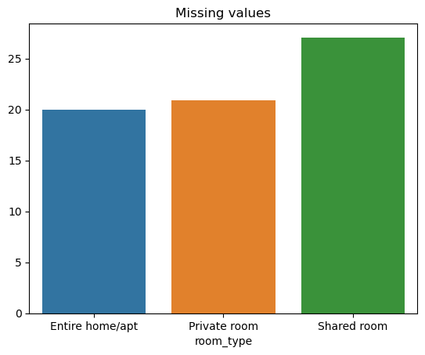
Missing Value analysis ‘Shared room’ has the highest missing value percentage (27%) for ‘last review’ feature while other room types has only about 20%

Slide 6
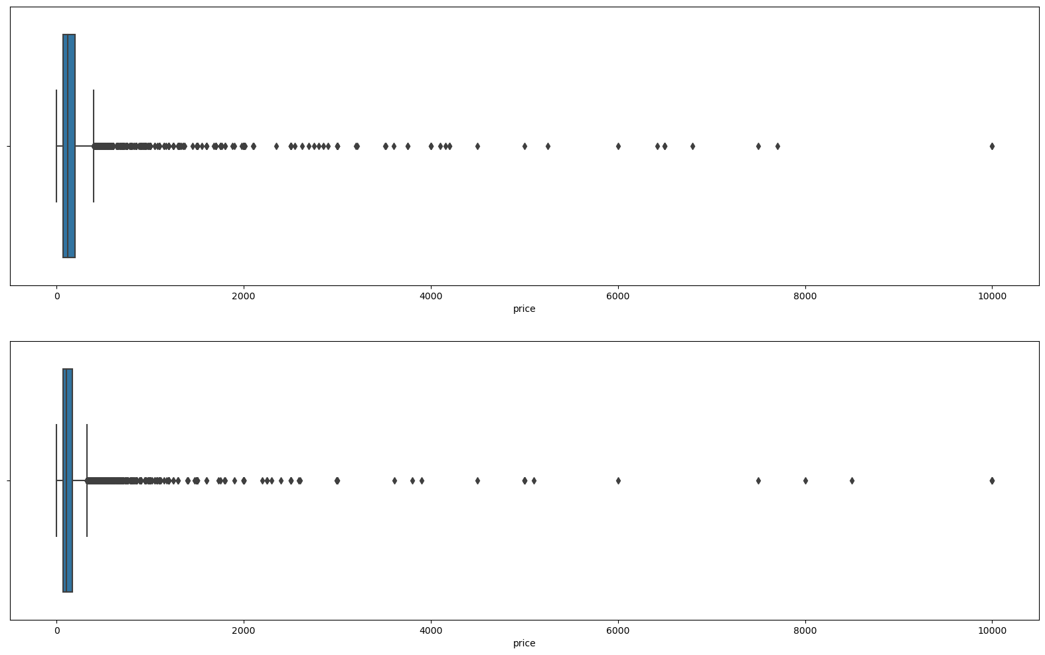
Missing Value analysis 1. The pricing is higher when 'last_review' feature is missing. 2. reviews are less likely to be given for shared rooms 3. When the prices are high reviews are less likely to be given 4. The above analysis seems to show that the missing values here are not MCAR (missing completely at random)

Slide 7
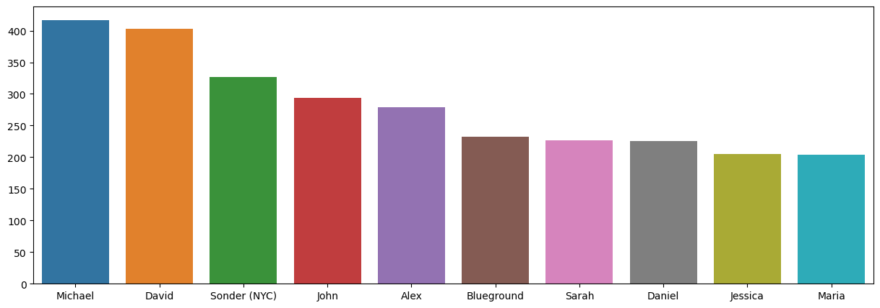
Univariate analysis Michael is the popular host and has been booked most number of times (i.e.) 417

Slide 8
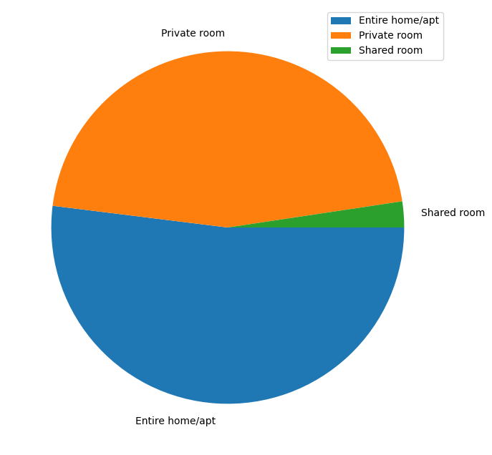
Preference of Room Type There are three types of rooms – 1. Entire home/Apartment 2. Private room 3. shared room Overall, customers appear to prefer private rooms (45%) or entire homes (52%) in comparison to shared rooms (2.4%).

Slide 9
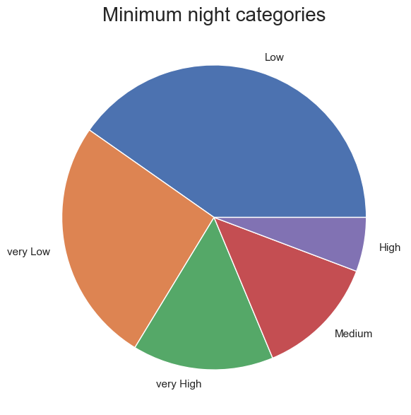
Minimum Night categories Customers prefer to to leave reviews for lower number of minimum nights

Slide 10
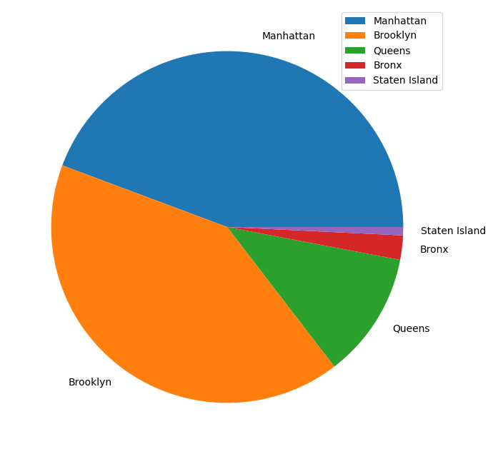
Neighborhoods 1. Manhattan and Brooklyn has the highest neighborhood contribution. 2. Staten Island has the lowest contribution.

Slide 11
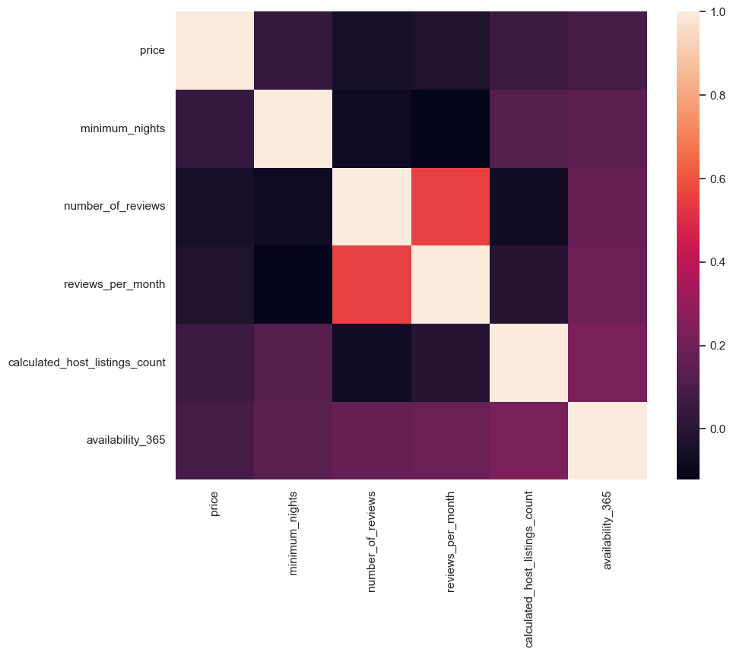
Multivariate analysis Insights from the correlation between reviews and other factors might be useful in targeting marketing efforts to boost bookings for listings that are lagging in performance.

Slide 12
Conclusion
Strong significant insights are derived based on various attributes in the dataset.
Ample amount and variety of visuals can used in the presentations for the stakeholders.
Data collection team should collect data about review scores so that it can strengthen the later analysis.
A clustering machine learning model to identify groups of similar objects in datasets with two or more variable quantities can be made.

